Slide 1
So You Want to Learn Latex
Introduction to Latex and what it can do for you

Slide 2
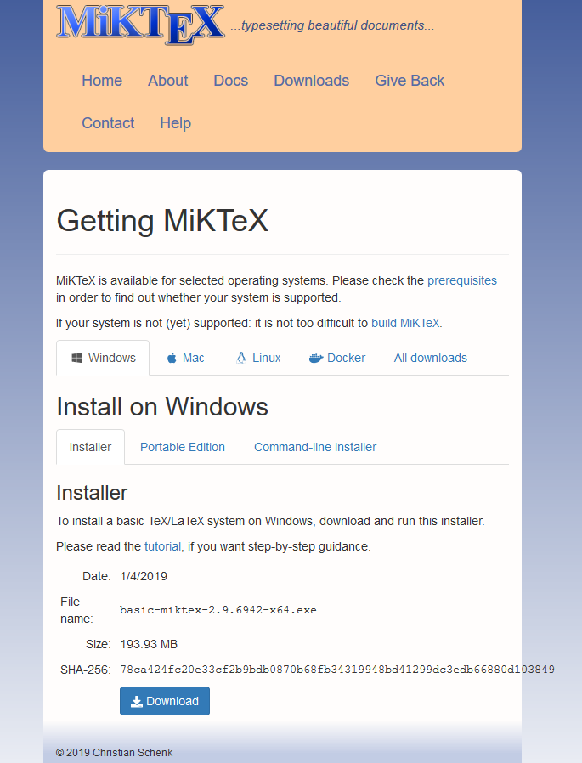
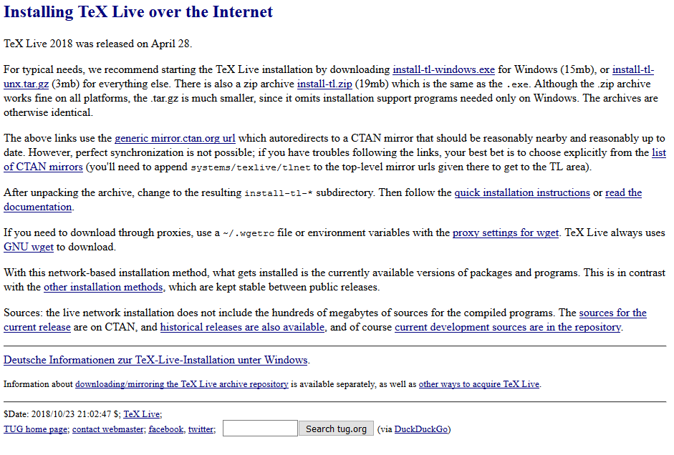
Installing Latex
Both MikTeX and TeX Live are used distributions
Both programs keep an up-to-date index of all packages on CTAN (Comprehensive TeX Archive Network)
CTAN is an archive of all the packages people write
Think of these as distribution programs of Python: Anaconda or Continuum
https://miktex.org/ https://www.tug.org/texlive/

Slide 3
Online Latex
Many people like to use an online distribution of Latex
Overleaf has the latest Texlive package manager and a decent interface.
https://www.overleaf.com/

Slide 4
Installing a LateX IDE
Like any programing language, LateX has a large amount of IDEs (Integrated Development Environment)
Most IDE’s are free and it really comes down to personal preferences.
There are websites like Overleaf / Sharelatex (https://www.overleaf.com/, https://www.sharelatex.com/) that have their own IDEs and will compile the code every time you make a change.
I personally like an IDE that has a pdf preview window after compiling.
Some common IDE’s
TeXstudio: https://www.texstudio.org/
TeXworks: http://www.tug.org/texworks/
TeXmaker: http://www.xm1math.net/texmaker/
LyX: https://www.lyx.org/

Slide 5
Including a Package
Using a package is very similar to including a package in a piece of code
In LateX, type \usepackage{package name}
Each package has it’s own documentation and options when including the package.
Instead of \usepackage{geometry}, typing in \usepackage[a4paper, margin = 2cm]{geometry} will give a paper layout of A4 paper size with 2cm margins on both sides, top, and bottom.
Some useful LateX packages for scientific papers:
For typing maths: \usepackage{amsmath, amssymb, amsfonts}
For including graphics: \usepackage{graphic, subcaption, subfig}
To manage paragraphs: \usepackage{parskip}
To manage page margins: \usepackage{geometry}
To manage references: \usepackage{natbib}
For Drawing graphics: \usepackage{tikz}
For managing headers: \usepackage{fancyhdr}

Slide 6
Formatting a Page
Each page is divided into sections using the \section{*Title goes here*} command. Each section can be divided into subsections by adding the word sub before section. The following is a list of all the section commands:
\section{*Title goes here*}
\subsection{*Title goes here*}
\subsubsection{*Title goes here*}
\paragraph{*Title goes here*}
Some packages will allow you to divide the section further if you desire.

Slide 7
Resources if you’re stuck
https://tex.stackexchange.com/
https://latex.org/forum/
https://www.overleaf.com/learn/latex/
https://texfaq.org/FAQ-TeXsystems
List of math symbols: https://oeis.org/wiki/List_of_LaTeX_mathematical_symbols

